Slide 1
Software Development Methodologies
Jerry Lebowitz

Slide 2
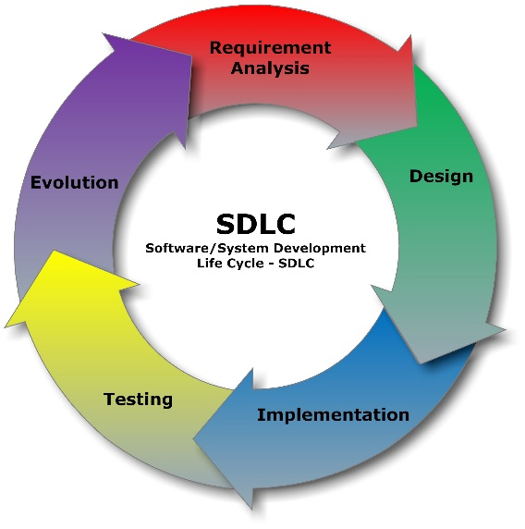
Software Development Methodologies

Slide 3

Agile Manifesto
We are uncovering better ways of developing software by doing it and helping others do it
Through this work we have come to value:
Individuals and interactions over processes and tools
Working software over comprehensive documentation
Customer collaboration over contract negotiation
Responding to change over following a plan
That is, while there is value in the items on the right, we value the items on the left more

Slide 4

Agile
Approach for developing software
On-going customer feedback
Strong team interaction as opposed to memos and e-mail
Used to deliver quality software products faster

Slide 5
Agile Frameworks
Extreme Programming (XP)
Crystal
RUP
Scrum

Slide 6

Extreme Programming
Extreme Programming (XP) is a software development methodology which is intended to improve software quality and responsiveness to changing customer requirements
Advocates frequent "releases" in short development cycles, which is intended to improve productivity and introduce checkpoints where new customer requirements can be adopted

Slide 7

Extreme Programming Paradigms(1)
Pair programming
Two developers working on the same computer
Two eyes are better than one
Small releases
Release software every two to four weeks
System metaphor
All programmers should understand the whole system
Refactoring
Continually clean up the code

Slide 8
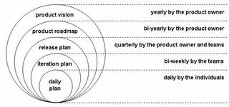
Extreme Programming Paradigms(2)
Continuous integration
Build the entire software baseline at least once a day
Coding standards
All programmers must following a well established standard
Collective code ownership
All programmers should be able to change any software

Slide 9
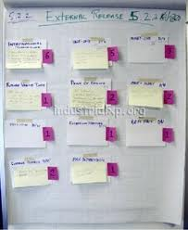
Extreme Programming Paradigms(3)
Simplicity
Design everything as simple as possible
Planning game
Iteration Planning: This plans the activities and tasks of the developers
Release Planning: This is focused on determining what requirements are included in which near-term releases, and when they should be delivered
Whole team
Everyone needs to be involved
Customers, users, developers, testers, etc.

Slide 10
Extreme Programming Paradigms(5)
Sustainable pace
programmers should not work more than 40 hour weeks
Test driven development
Each new feature begins with writing a test
This test must inevitably fail because it is written before the feature has been implemented
The next step is to write some code that causes the test to pass
Go back to step 1

Slide 11
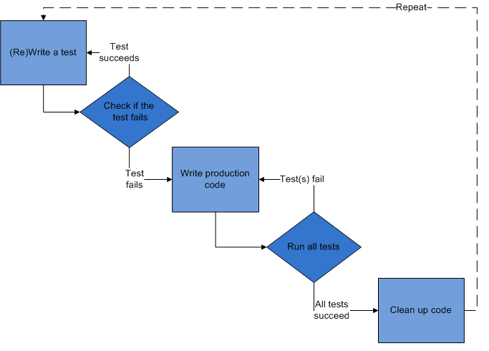
Test Driven Development

Slide 12
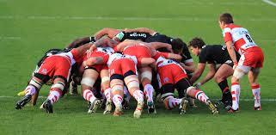
Scrum
Iterative, incremental framework
Encourages continuous improvement
Small pieces of functionality are developed and tested

Slide 13

Scrum vs. Waterfall (1)
Volatile requirements
Waterfall – may cause extensive rework
Scrum – should require reduced rework due to the iterative nature
Product
Waterfall – Customer views the finished product
Scrum – Customer constantly sees the product (more confidence)

Slide 14

Scrum vs. Waterfall (2)
Visibility
Waterfall – Little visibility
Scrum – Progress is constantly demonstrated
Verification
Waterfall – Begins after implementation (development) is complete
Scrum – Constantly testing using continuous integration

Slide 15
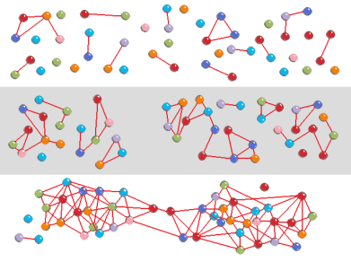
More on Scrum
Software development teams are self-directed, self-organizing, cross-functional
There is no overall team leader
Software teams continually learn as development proceeds
Software teams anticipate requirement changes
Software teams constantly verify software and adapt
Software teams are always able to deliver functionality

Slide 16
Team Roles
Product owner
Scrum master
Team member

Slide 17

Others
Managers
Interested parties (stakeholders)
Customers
CEO

Slide 18

Chicken and the Pig Scenario
A Pig and a Chicken are walking down the road.
The Chicken says: "Hey Pig, I was thinking we should open a restaurant!"
Pig replies: "Hm, maybe, what would we call it?"
The Chicken responds: "How about 'ham-n-eggs'?"
The Pig thinks for a moment and says: "No thanks. I'd be committed, but you'd only be involved."

Slide 19

Product Owner
Has the vision of what needs to be developed
Conveys that vision to the scrum team
Knows the customer’s priorities
Manages the backlog (features that need to be developed)
Determines when a feature has been implemented
Available to the team to answer questions
Single person

Slide 20

Scrum Master
Responsible for making sure a Scrum team lives by the values and practices of Scrum
Often considered a coach for the team
Helping the team do its best work
Facilitates continuous improvement
Process owner for the team
Protects the team by making sure they do not over-commit
Firewall for the team
Removes barriers
Anything that impedes the progress of the team

Slide 21

The Team
Three to nine individuals (cross functional )
Self organizing, self managed
Responsible for performing the work (writing the software, etc.)
Need to establish ground rules for the team
Team usually become more effective as time as progresses

Slide 22
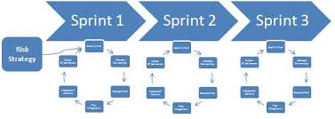
Scrum Definitions (1)
Sprint
The basic unit of development in Scrum
A sprint is a “timeboxed" effort; that is, it is restricted to a specific duration
The duration is fixed in advance for each sprint and is normally between one week and one month, although two weeks is typical

Slide 23

Scrum Definitions (2)
User story
One or more sentences in the everyday language of the end user that captures what needs to be developed
Use Case
Format: “As a <type of user>, I want <some goal> so that <some reason>
Contains a detailed description, story point estimation, list of assumptions, priority, assignee(s), list of tasks and tests, definition of done

Slide 24

Scrum Definitions (3)
Backlog
Work to be done
Composed of stories
Story point
A story point is a relative measure used to determine (or estimate) the difficulty of implementing a given user story
Velocity
Story Points earned per sprint
Definition of Done
A clear and concise list of requirements that software must adhere to for the product owner to call it complete

Slide 25

Definition of Done
Code produced that adheres to a coding standard
Code commented
Code checked into source control system
Peer reviewed (or produced with pair programming)
Unit tests written and passed
Relevant documentation/diagrams produced and/or updated
Product owner concurs
What the customer sees to verify the story was implemented correctly

Slide 26
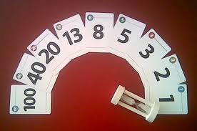
Planning Poker
Planning poker is a consensus-based technique for estimating effort
Mostly used to estimate effort or relative size of user stories
Uses a skewed Fibonacci series

Slide 27
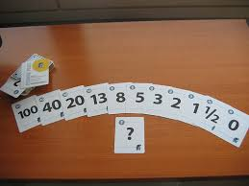
Planning Poker (2)
Members of the group make estimates by playing numbered cards face-down to the table, instead of speaking them aloud
The cards are revealed, and the estimates are then discussed
By hiding the figures in this way, the group can avoid the cognitive bias of anchoring where the first number spoken aloud sets a precedent for precedent for subsequent estimates

Slide 28
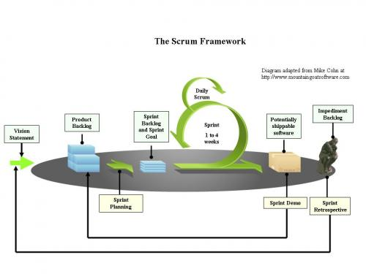
Scrum Process Summarized

Slide 29

Scrum Meetings
Meeting | Frequency | Participants | Output
Product Planning | Before the first Sprint | Product owner (PO) and stakeholders | Product backlog
Sprint Planning 1 | At the beginning of each Sprint | PO, Scrum Master and Team | Sprint backlog
Sprint Planning 2 | After Sprint Planning 1 | Scrum Master and Team | Sprint backlog decomposed into tasks
Daily standup (Scrum) | Daily | Scrum Master and Team | Updated status
Sprint demonstration | At the end of each Sprint | PO, Scrum Master and Tea | Completed or not completed stories
Sprint Retrospective | After the demonstration meeting | PO, Scrum Master and Team | Continually improvement

Slide 30
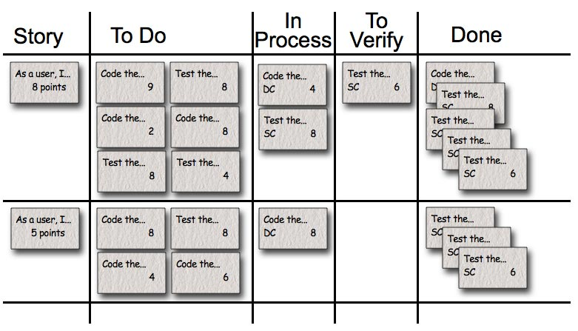
Keep Track of Progress
Use an agile management tool
Rational Team Concert (RTC), Jira, Scrumworks, VersionOne
Use an agile task board

Slide 31
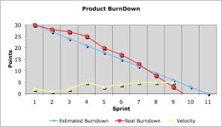
Product Burndown Chart

Slide 32
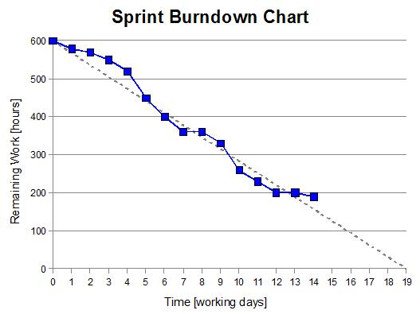
Sprint Burndown Chart

Slide 33
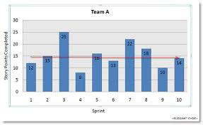
Velocity Metric Chart

Slide 34

Scrum at Large
Scrum teams are 3 – 9 individuals
If a project has 100 developers
Multiple teams are formed
Scrum of Scrums meetings are held

Slide 35

Agile Quotes

